Slide 1

Desktop Reference Guide of LEAP Top 10 Key Concepts

Slide 2
Presented by Team SharkBait
Dede Eischens Jackie Merriman
Lionel Lawson Monica Owczarzak
Scott Marko Katelyn Starkey
Developed through the Leadership Excellence in Acquisition Program (LEAP) at the Partnership for Public Service
Please see other leadership programs offered by the
Partnership for Public Service at: https://ourpublicservice.org/
Notes:
Congratulations for participating in the Leadership Excellence in Acquisition Program (LEAP). This desktop reference guide has been developed by participants in the 2016-2017 LEAP cohort. It highlights the top 10 key concepts that our group learned while participating in LEAP. The guide is yours to tailor and fit your home organization. Whether you tailor the presentation materials to fit your immediate team or tailor to suit the need of your entire workforce organization, the intent of the guide is that it is a starting point for you to take what you have learned during LEAP and bring some of those lessons back to your current work environment. The training is designed so you can use it as 10 individual one hours sessions or condense into a 1-2 day program.

Slide 3
Table of Contents
Topic 1 Values, Vision and Mission – understanding yourself as a leader … 4 Topic 2 Servant Leadership and Exploring your Leadership Style …………. 24
Topic 3 Understanding the Dynamics of Teams …………………………..…....... 41
Topic 4 Effective Communication Techniques and Skills ……………….……… 59
Topic 5 Crucial Conversations ………………………………………………………………. 79
Topic 6 Skills for Managing & Motivating Staff at all Levels to Perform and Contribute to an Organization…………………………………………………….………… 85
Topic 7 Leveraging individual differences to maximize performance ...... 104
Topic 8 Driving Innovation……………………………………………………………………. 118
Topic 9 Understanding the Dynamics of Power and Influence……………… 138
Topic 10 Collaboration and Navigating Change……………………………..……… 156

Slide 4

Topic 1: Values, Vision and Mission – Understanding Yourself as a Leader
Notes:
LEAP Session 1 Values, Vision and Mission – understanding yourself as a leader

Slide 5
Comparing Management and Leadership
BOTH MANAGEMENT AND LEADERSHIP INVOLVE Deciding what needs to be done Creating networks of people and relationships to accomplish the agenda Ensuring people actually do the job
MANAGEMENT IS COPING WITH COMPLEXITY Brings order and Consistency Incremental Improvements | LEADERSHIP IS COPING WITH CHANGE Identifying and understanding major changes to survive and compete
PLANNING AND BUDGETING Goals Project tasks Resource allocation Designed for results, not change Deductive | SETTING DIRECTION Vision Strategies “What it should be” Inductive: gathering variety of data and information
Notes:
Adapted from John Kotter “What Leaders Really Do,” Harvard Business Review, May-June 1990. Refer to LEAP training resource materials.

Slide 6
Comparing Management and Leadership
ORGANIZING AND STAFFING Structure Focus on employees / staff | ALIGNING PEOPLE Communication Focus on stakeholders, customers, staff, etc. Develop credibility Empowerment through clear sense of direction
Notes:
Refer to LEAP training resource materials.

Slide 7
Comparing Management and Leadership
CONTROLLING AND PROBLEM SOLVING Control mechanisms compare system behavior w/ plan and take action when necessary Planning sets targets Organizing builds organization to achieve targets Control process makes certain quality lapses are spotted immediately | MOTIVATING PEOPLE Articulate vision in manner that stresses values audience leader is addressing Involve people in deciding how to achieve the agency vision (or part most relevant to a particular individual – gives people a sense of context and ownership) Support employee efforts to realize vision by providing: Coaching Feedback Role modeling Recognize and reward success
Notes:
Refer to LEAP training resource materials.

Slide 8
Values
How we intend to live as we pursue our mission
Values are our deeply held beliefs of what is worth living for. Values come from many sources: parents, religion, schools, peers, people we admire, and the culture in which we live. We acquire many values during our formative years; others we acquire during our adult years. Values play a major role in the decisions we make and the behaviors we engage in. Thus, values are crucial when it comes to how we live our lives as individuals, and how we perform as members of teams and organizations.
Notes:
Refer to LEAP training resource materials.
Examine the list of personal, team and organization values that follows. Feel free to add as many values of your own that are not on the list. Select the five values that are most important to you. Write each on a separate card.

Slide 9
Values
Exercises
What do you want your reputation to be?
FAR Subpart 1.1 – Purpose, Authority, Issuance
Identify core values that you see reflected in the document.
How do you see these values evidenced in Acquisition?
How can you promote these values as an Acquisition leader?
Notes:
Refer to LEAP training resource materials.
Exercise 1: Are you living a life consistent with your values? Do your values align with the organizations?
What can you tackle and what can you let go of? Be mindful of what I’m doing to facilitate my values? What are behaviors I want others to have? What am I doing to give people time and space for that?
Exercise 2:
FAR Subpart 1.1 – Purpose, Authority, Issuance

Slide 10
Eight Steps Toward Integrity
Doing What We Say We Will Do:
This is a pragmatic definition of integrity and a basic practice. It includes keeping promises and meeting deadlines. Succeeding at this requires careful consideration – and often, tough negotiation – prior to making commitments.
Doing the Right Thing:
With the awareness of what’s right comes the obligation of right action. That means embodying our convictions – and accepting the consequences.
Taking Responsibility:
Acknowledge our complete, sole responsibility for every one of our actions. No more seeing other people and outside events as the cause of our problems. Blame no one, accept the behavior of others and the circumstances of our lives as givens, and proceed from there. When we see something in the world that we don’t like, we recognize our personal responsibility either to change or accept it.
Notes:
Refer to LEAP training resource materials.

Slide 11
Eight Steps Toward Integrity
Supporting Our Own Weight:
Harking back to structural integrity, this means functioning as a whole, being able to support all the elements of our own lives. Examples include being physically fit and financially sound.
Holistic Thinking:
Since integrity is a quality of wholeness, an appreciation of wholeness in the world supports its practice. There’s nothing wrong with compartmentalization or reductionist thinking, but don’t let that obscure the big picture.
Respecting Others:
Invoke integrity in other people by treating them with respect – even when they do not live up to our expectations. Acknowledge that our own standards are always subject to question, while affirming that the errors of others do not diminish our own integrity. We get the best from others in an atmosphere that supports doing right.
Notes:
Refer to LEAP training resource materials.

Slide 12
Eight Steps Toward Integrity
Checking the Mirror:
When we err – as we will, again and again – the best response is to pause for reflection. We can ask ourselves: Is this what I really want? Is this who I am?
Defining the Rules and Values:
Explicit agreement about these basics enables groups of people, from couples to business organizations to nations, to benefit from the integrity of members. Absent consensus, personal integrity can lead dissenting individuals to subvert the group. Among people sharing the same intentions, by contrast, disagreements can help to refine and improve ideas for the benefit of all.
Notes:
Refer to LEAP training resource materials.

Slide 13

Legacy Statement
Imagine that you are 75 years old and are about to retire and leave the area. Your family, co-workers, friends and neighbors have assembled to celebrate the culmination of your career, life and contributions.
Create a list of the things you
would like to have said about
you – your life, your work, your
accomplishments, your contributions,
etc. for which you will be remembered.
Notes:
Refer to LEAP training resource materials.
Share with the person next to you some of the factors you have included in your legacy statement.

Slide 14
Max De Pree’s 10 Essential Elements for Leaving a Positive Legacy
Legacy requires a competence in establishing and maintaining relationships.
A true legacy establishes a direction that is clearly observable.
Fending for the truth can become a legacy.
In building a legacy, we choose to become personally accountable.
A legacy sets standards.
Guiding legacies lift the spirit.
A legacy requires constructive constraints and seeks simplicity as an essential condition of life.
Those concerned with legacy strive to integrate their lives upward.
A legacy lives in the actions of many people.
A legacy is the most significant way of saying thank you to an organization and to the people with whom we work.
Notes:
Refer to LEAP training resource materials.
The 10 Essential Elements for Leaving a Positive Legacy are from an article by Bernice Ledbetter, who is the director of the De Pree Ledership Center in Pasadena, CA. She can be reached at depree@fuller.edu.

Slide 15

Emotional Intelligence
A set of emotional and social skills that influence the way we perceive and express ourselves, develop and maintain social relationships, cope with challenges, and use emotional information in an effective and meaningful way.
Notes:
Refer to LEAP training resource materials.
Instructor to lead class discussion on the topic.

Slide 16
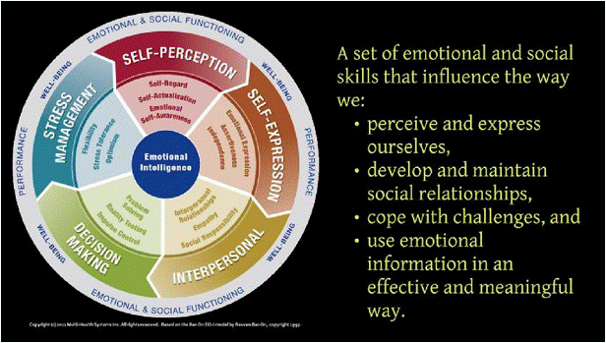
Emotional Intelligence
Notes:
Refer to LEAP training resource materials.
EQ-I 2.0 test for purchase:
https://www.mhs.com/area?market=Talent#EQ2

Slide 17

Self Perception
Self-Regard
Self-Actualization
Emotional Self-Awareness
Notes:
Refer to LEAP training resource materials.
SELF PERCEPTION Having a solid understanding of oneself, one’s emotions and one’s inner life allows one to better express thoughts and feelings.
SELF-REGARD • Self-regard is respecting oneself while understanding and accepting one’s strengths and weaknesses. • Self-Regard is often associated with feelings of inner strength and self-confidence.
SELF-ACTUALIZATION • Self-Actualization is the willingness to persistently try to improve oneself and engage in the pursuit of personally relevant and meaningful objectives that lead to a rich and enjoyable life.
EMOTIONAL SELF-AWARENESS • Emotional Self-Awareness includes recognizing and understanding one’s own emotions. • This includes the ability to differentiate between subtleties in one’s own emotions while understanding the cause of these emotions and the impact they have on the thoughts and actions of oneself and others.

Slide 18
Johari Window
 | Known to Self | Not Known to Self
Known to Others | I Area of Free Activity | II Blind Area
Not Known to Others | III Avoided or Hidden Area | IV Area of Unknown Activity
Notes:
Refer to LEAP training resource materials.
Graphic model of awareness in interpersonal relations.
Quadrant I. The area of free activity or public area refers t behavior and motivation known to self and known to others.
Quadrant II. The blind area is that area where others can see things in ourselves of which we are unaware.
Quadrant III. The avoided or hidden areas, represents things we know but do not reveal to others (e.g. hidden agenda, or matters about which we have sensitive feelings).
Quadrant IV. Areas of unknown activity. Neither the individual nor others are aware of certain behaviors or motives. Yet, we can assume their existence because eventually some of these behaviors and motives were influencing relationships all along.

Slide 19

Interpersonal
Interpersonal Relationships
Empathy
Social Responsibility
Notes:
Refer to LEAP training resource materials.
A healthy network of relationships gives one greater resources from which to gather information and process it accordingly and seek feedback in order to arrive at optional solutions.
INTERPERSONAL RELATIONSHIPS • Interpersonal relationships refer to the skill of developing and maintaining mutually satisfying relationships that are characterized by trust and compassion.
EMPATHY • Empathy is recognizing, understanding, and appreciating how other people feel. • Empathy involves being able to articulate your understanding of another’s perspective and behaving in a way that respects others’ feelings.
SOCIAL RESPONSIBILITY • Social responsibility is willingly contributing to society, to one’s social groups, and generally to the welfare of others. • Social Responsibility involves acting responsibly, having social consciousness, and showing concern for the greater community.

Slide 20

Self-Expression
Emotional Expression
Assertiveness
Independence
Notes:
Refer to LEAP training resource materials.
Being able to openly and honestly express one’s true thoughts and feelings enables one to have healthy relationships and interactions built on trust.
EMOTIONAL EXPRESSION • Emotional expression is openly expressing one’s feelings verbally and non-verbally.
ASSERTIVENESS • Involves communicating feelings, beliefs and thoughts openly, and defending personal rights and values in a socially acceptable, non-offensive, and non-destructive manner.
INDEPENDENCE • Independence is the ability to be self directed and free from emotional dependency on others. • Decision-making, planning, and daily tasks are completed autonomously

Slide 21

Decision Making
Problem Solving
Reality Testing
Impulse Control
Notes:
Refer to LEAP training resource materials.
Feeling competent, calm and grounded in one’s ability to use emotional information to make decisions renders one better equipped to deal with everyday stressors, without being derailed by emotions.
PROBLEM SOLVING • Problem Solving is the ability to find solutions to problems in situations where emotions are involved. • Problem solving includes the ability to understand how emotions impact decision making.
REALITY TESTING • Reality testing is the capacity to remain objective by seeing things as they really are. • This capacity involves recognizing when emotions or personal bias can cause one to be less objective.
IMPULSE CONTROL • Impulse control is the ability to resist or delay an impulse, drive or temptation to act. • It involves avoiding rash behaviors and decision making.

Slide 22
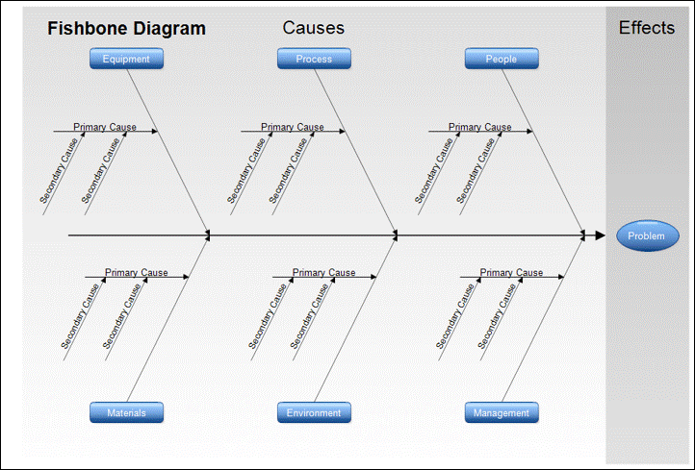
The Ishikawa Diagram
Notes:
Refer to LEAP training resource materials.
This diagram is used to identify all of the contributing root causes likely to be causing a problem.

Slide 23
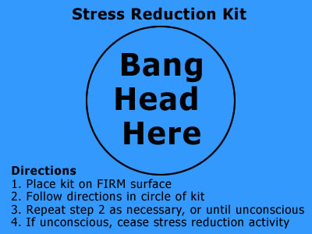
Stress Management
Flexibility
Stress Tolerance
Optimism
Notes:
Refer to LEAP training resource materials.
Feeling resilient in the face of adversity and armed with an arsenal of coping strategies heightens feelings of self-security, confidence and a deeper understanding of oneself and one’s strengths.
FLEXIBILITY • Flexibility is adapting emotions, thoughts and behaviors to unfamiliar, unpredictable, and dynamic circumstances or ideas.
STRESS TOLERANCE • Stress tolerance involves coping with stressful or difficult situations and believing that one can manage or influence situations in a positive manner.
OPTIMISM • Optimism is an indicator of one’s positive attitude and outlook on life. • It involves remaining hopeful and resilient, despite occasional setbacks.

Slide 24
Effective Leadership
TAKING A STAND |  | STAYING CONNECTED
Effective leadership requires constantly choosing the right balance between Taking a Stand and Staying Connected.
Choosing this balance correctly is an art….every situation requires a unique balance.
Ultimately a leader who has been truly effective has worked the balance. They are not necessarily “liked” by everyone – but their leadership stand is clear and yet they are “in touch” with people and have their support.
Notes:
Refer to LEAP training resource materials.
Some situations require a clear leadership stand (e.g. in the “heat of battle”; others require strong “connecting” with others (“getting to know your people.”)
Most often we tend to naturally gravitate toward one or the other. Some easily take a stand but find it difficult to connect with people. Others are strongly connected but find it difficult to take a stand.

Slide 25




Questions?

Slide 26

Topic 2: Servant Leadership and Exploring Your Leadership Style
Notes:
LEAP Session 1 Understanding Yourself as a Leader

Slide 27

Servant Leadership Defined
Servant leadership is a practical philosophy, which supports people who choose to serve first, and then lead as a way of expanding service to individuals and institutions.
May or may not hold formal leadership positions.
Encourages collaboration, trust, foresight, listening and the ethical use of power and empowerment.
Notes:
Refer to LEAP training resource materials.

Slide 28
Harvard Business Review Article: Servant Leadership: A Powerful Tool for Fast Change
Notes:
Key Points from the article:
Servant leader is servant first – wanting to bring value by lifting up others and doing what supports the greater good for all.
Test of servant leadership: “Do those served grow as persons, do they while being served becomes healthier, wiser, freer, more autonomous (self reliant), more likely themselves to become servants?
Instructor to facilitate class discussion of the article – it is recommended to provide the reading prior to the session

Slide 29
Growing from Traditional Boss to Servant Leader
Traditional Boss | Servant-Leader
Motivated by personal drive to achieve | Motivated by desire to serve others
Understand internal politics and uses it to win personally | Sensitive to what motivates others and empowers all to win with shared goals and vision
Controls information to maintain power | Shares big-picture information generously
Eager to speak first; feel his/her ideas are most important | Most likely to listen first; values others’ input and builds strength through differences
Gives orders; sees too much listening or coaching as inefficient | Listens deeply and respectfully to others, especially to those who disagree
Notes:
Refer to LEAP training resource materials.
Pose question to the learners: Which would you rather be?

Slide 30

10 Principles of Servant – Leadership
Notes:
Refer to LEAP training resource materials.
Characteristics critical to the development of servant leaders
Discuss each characteristic with the learners and ask for examples in the workplace

Slide 31

Listening
Reinforce communication and decision making skills by making a deep commitment to listening intently to others
Seek to identify and clarify the will of a group
Seek to listen receptively to what is being said (and not said)
Getting in touch with one’s inner voice
Seeking to understand what one’s body, spirit
and mind are communicating
Notes:
Refer to LEAP training resource materials.

Slide 32
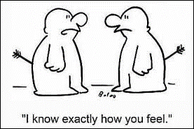
Empathy
Strive to understand others
People need to be accepted and recognized for their special and unique spirit
Assume to good intentions and don’t reject people, even when forced to reject people’s behavior or performance
Notes:
Refer to LEAP training resource materials.

Slide 33

Healing
Powerful force for transformation and integration
Servant leadership has a potential for healing one’s self and others
Notes:
Refer to LEAP training resource materials.

Slide 34
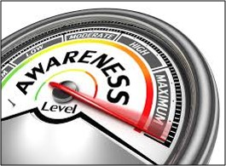
Awareness
General awareness, especially self-awareness, strengthens you as a leader
Notes:
Refer to LEAP training resource materials.

Slide 35
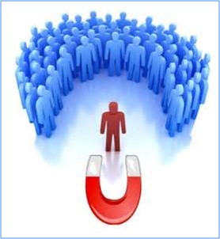
Persuasion
Rely on persuasion, rather than positional authority in making decisions
Seek to convince others, rather than coerce compliance
Effective at building consensus within groups
Notes:
Refer to LEAP training resource materials.

Slide 36

Conceptualization
Seek to nurture their abilities to “dream great dreams”
One must think beyond day-to-day realities
Seek a delicate balance between big picture thinking and day-to-day focus
Notes:
Refer to LEAP training resource materials.

Slide 37
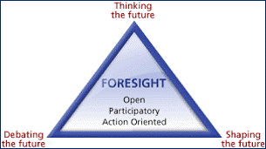
Foresight
Enables you to understand lessons from the past, the realities from the present and the likely consequence of a decision from the future
Deeply rooted in the intuitive mind
Notes:
Refer to LEAP training resource materials.

Slide 38

Stewardship
All stakeholders play a significant role in holding their organization in trust for the greater good of society
Notes:
Refer to LEAP training resource materials.

Slide 39

Commitment to the Growth of People
All people have an intrinsic value beyond their tangible contributions as workers
Deeply committed to a personal,
professional and spiritual growth
of each and every individual within
the organization
Notes:
Refer to LEAP training resource materials.

Slide 40

Building Community
Be aware that the shift from local communities to large institutions as the primary shaper of human lives has changed our perceptions
Seek to identify a means for building community among those who work within a given institution
Notes:
Refer to LEAP training resource materials.

Slide 41

Exercise
Considering what you learned about the topic of Servant Leadership, consider your own style of leadership and share how you will adjust to practice servant leadership.
Notes:
Refer to LEAP training resource materials.
Facilitate group discussion on the topic of servant leadership and have the students write out commitment cards to hold themselves accountable post training.

Slide 42
Questions?

Slide 43

Topic 3: Understanding The Dynamics of Teams
Notes:
LEAP Session 2 Leading Teams

Slide 44
What is the DiSC® Assessment Tool?
The DiSC assessment is a tool used for discussion of people's behavioral differences. If you choose to take the DiSC assessment, you will be asked to complete a series of questions that produce a detailed report about your personality and behavior.
The report provides information on understanding DiSC behavior styles. What are the DiSC behavior styles?
Notes:
LEAP Session 2 Leading Teams
DiSC assessment tool is available on the internet. Approximately cost is $60

Slide 45
Notes:
LEAP Session 2 Leading Teams
Review LEAP materials; Share the results of your DiSC with the learners
If you plan to purchase assessments for the learners, it is recommended to refer to the LEAP materials for guidance, in addition to the DiSC website to be able to knowledgeably review the results with the class.

Slide 46
Why Your Brain Loves Good Storytelling
Harvard Business Review
Paul J. Zak
Notes:
Paul J. Zak is a professor at Claremont Graduate University and President of Ofactor, Inc.
Stories activate multiple senses in the brain including motor, auditory, and visual. Discuss how and why stories are easier to recall. Use time during the learning to discuss the role of storytelling in acquisitions. Discuss how to empathize with the pain customers may experience and the pleasure they may feel when pain is resolved. Stories provide motivation for action. Discuss how storytelling helps learners with various acquisitions and interactions with their customers and peers. Explain what a compelling human-scale story is and ask learners to discuss situations where they’ve used storytelling in their daily interactions. What were some of the impacts, e.g. positive and negative.

Slide 47

https:www.youtube.com/watch?v=AL-PAzrpqUQ Persuasion and the Power of Story: Jennifer Aaker
Storytelling
Notes:
Refer to LEAP training resource materials on the benefits of storytelling

Slide 48

What is Your Purpose?
Educate
Obtain Input
Persuade
Advocate
Recommend
Invite
Inquire
Ask for approval
Make a decision
Change behavior
Notes:
Explain how to communicate the purpose of your narrative? Are you seeking to educate, obtain input, or some other outcome?

Slide 49
Polish Your Pitch
Who are you presenting to? What is their knowledge base and how does this inform what you share?
What does my audience need to know (content) about what I am presenting? How do I balance big-picture with details?
What is a compelling way to engage the audience (i.e. how do I create emotional connection through story?)
How do I want to present the information (i.e. data, visual)
How will I interact with the audience? What requests or questions do I want to pose that will help my audience make an informed decision?
Notes:
LEAP Session Two – Leading Teams
Questions to ask yourself when communicating with your audience, which may consist of peers, leadership, and/or colleagues

Slide 50
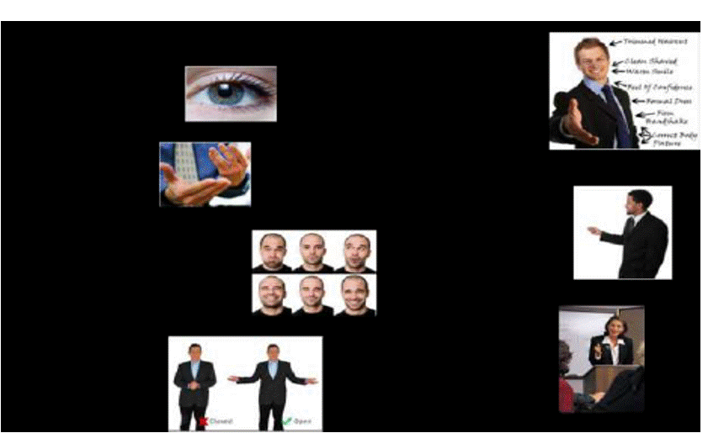
Platform Skills
Eye Contact
Appearance
Gestures
Movement
Facial Expressions
Verbal Skills
Pitch
Pace,
Pause
Project
Posture
Notes:
Refer to LEAP training resource materials.
Practice exercise – write and deliver pitch to practice storytelling

Slide 51
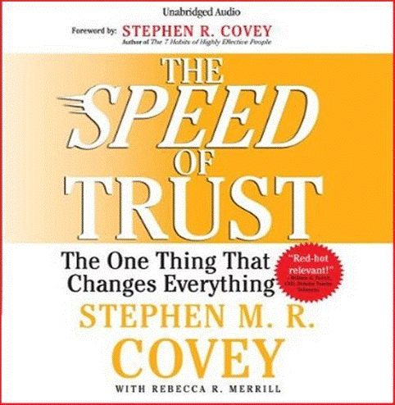
The Speed of Trust
Notes:
Refer to LEAP training resource materials.
This book is available in audio @ https://www.youtube.com/watch?v=vbTBIwg3bm0
The Speed of Trust offers a practical look at how trust functions in our every transaction and relationship—from the most personal to the broadest, most indirect interaction—and how to establish trust immediately.
Encourage the learners to listen to the audio book
Meet with learners to discuss different chapters in the book and how the information relates to their work environment.
How important is trust to the learners? Give examples of how trust can erode the acquisition process and how it improves the process.

Slide 52
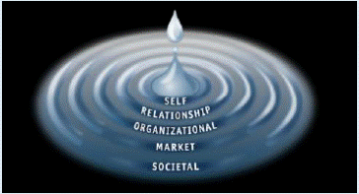
Speed of Trust
The Economics of Trust
Low Trust = High Speed, High Cost
High Trust = High Speed, Low Cost
The Five Waves of Trust
Self Trust
Relationship Trust
Organizational Trust
Market Trust
Societal Trust
Notes:
Refer to LEAP training resource materials.

Slide 53
Speed of Trust
Am I someone who others can trust?
“Cores” that are key to building credibility:
Integrity (honesty, congruency, humility, courage)
Intent (motive, agenda, behavior)
Capabilities (talents, attitude, skills, knowledge, and style)
Results (past, current, potential)
Notes:
Refer to LEAP training resource materials.
Also, refer to what you learned from reading the book. Book is available in audio. Recommend discussing specific sections from the book in a training session that is focused only on the concepts from the book.

Slide 54
Why is Trust in Acquisition Important?
Talk Straight
Demonstrate Respect
Create Transparency
Right Wrongs
Show Loyalty
Deliver Results
Get Better
Do Confront Reality
Clarify Expectation
Practice Accountability
Listen First
Keep Commitments
Extend Trust
Notes:
Refer to LEAP training resource materials.
Provide examples of why trust in acquisition is so critical for each of the points noted. Have the learners provide examples of each of the points to reinforce understanding of the concepts

Slide 55
The Four CORES of Credibility
Integrity and Intent are character cores. Capabilities and Results are competency cores. All Four Cores are necessary for credibility. A person of integrity that does not produce results is not credible. If you are not credible, you are not trustworthy.
Integrity
Intent
Capabilities
Results
Notes:
Refer to LEAP
Credibility boils down to two simple questions. First, do I trust myself? Second, am I someone who others can trust? Covey talks about Four “Cores” that are key to building credibility.

Slide 56
The Trust Matrix
Notes:
Refer to LEAP training resource materials.
The 10 Essential Elements for Leaving a Positive Legacy are from an article by Bernice Ledbetter, who is the director of the De Pree Ledership Center in Pasadena, CA. She can be reached at depree@fuller.edu.

Slide 57
The Trust Matrix
Character is a reflection of how you are on the inside, your intent, and the level of integrity you display in your relationships to others.
Competence is a reflection of how you are on the outside, your capability, and the results you achieve in your role.
Even though the focus on competence (capability and results) is important, these are skills that can be learned and accumulated over time. The focus on character (intent and integrity) may be more important because these qualities are required for bonding and are much more difficult to develop. Competence is about achieving results; character is about how you achieve them.
Notes:
Refer to LEAP training resource materials.

Slide 58
Trust Equation and Self Assessment
Reference: http://trustedadvisor.com/
Trustworthiness =
Credibility + Reliability + Intimacy
Self-Orientation
Notes:
Refer to LEAP training resource materials.
Complete Trust Equation and Self-Assessment
Discuss results
Review highest and lowest scores to find your greatest areas of strength and opportunities for improvement

Slide 59
Questions?

Slide 60

Topic 4: Effective Communication Techniques and Skills
Notes:
LEAP Session 2 Leading Teams

Slide 61
Set Clear Expectations
Who will do it?
What they will do and when will they have it done?
Example: “Can you please have the draft version of the project template ready for us to discuss at our 10 am meeting next Tuesday?”
Ensure the due by date is clear and mutually agreed upon
Example: Clarify possibly ambiguous terminology such as “COB” and “ASAP”
State the “check in process” if there is one:
Example: “Can we email updates by noon the day prior to our meetings so that we won’t just be covering the status but using the meeting to make decisions?”

Slide 62
Set Clear Expectations
How the task needs to be completed…
Depends on several factors, for example:
Level of competence and commitment
Level of comfort in delegating
Required level of detail
Clarify priorities, any complexities, estimated time expenditure, and scope
Share the “conditions of satisfaction” or standards, for example:
Are there people that need to be checked with or brought in the loop?
Is this a draft or should it be “signature ready?”
Is there data to be verified?
Why – provide context?
Most people want to know a little background information, where this task fits into the bigger picture and how it contributes to the whole

Slide 63
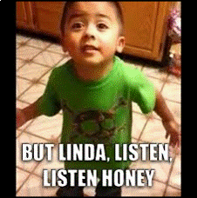
Listening
The biggest communication problem is we do not listen to understand. We listen to reply.

Slide 64
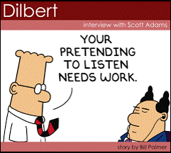
3 Levels of Listening
Internal Listening
Focused Listening
Global Listening
Notes:
Internal Listening: It is all about my thoughts, my judgments, my feelings and my expertise
Focused Listening: Hard-wired connection to other, lose awareness of outside world
Global Listening: Soft focus on other, aware of whole environment, including your own limitation

Slide 65
Internal Listening
At Level I, Internal Listening, our attention is on ourselves. We listen to the words of the other person but the focus is on what it means to us.
At Level I the spotlight is on "me": my thoughts, my judgments, my feelings, my conclusions about myself and others.
At Level I there is only one question: "What does this mean to me?"
Notes:
Source: Work Engagement.com
Link: http://www.workengagement.com/MN29CTXT/Materials/DoH%20The%20Levels%20of%20Listening%20version2.pdf

Slide 66
Focused Listening
At Level II, Focused Listening, there is a sharp focus on the other person.
With Focused Listening, you make your presence known. You can see it in people's posture when they are communicating at Level II; both leaning forward, looking intently at each other.
There is a great deal of attention on the other person and not much awareness of the outside world. We listen for words, expressions, emotions, what they don’t say.
Notes:
Source: Work Engagement.com
Link: http://www.workengagement.com/MN29CTXT/Materials/DoH%20The%20Levels%20of%20Listening%20version2.pdf

Slide 67
Global Listening
At Level III, Global Listening, you listen at 360 degrees. You listen as though you and the other person were at the "center of the universe receiving information from everywhere at once?”
Level III includes everything you can observe with your senses: what you see, hear, smell, and feel.
One of the benefits of learning to listen at Level III is greater access to your intuition. From your intuition you receive information that is not directly observable, and you use that information just as you'd use words coming from the other person’s mouth.
Level III is sometimes described as environmental listening (temperature, energy levels...).
Notes:
Source: Work Engagement.com
Link: http://www.workengagement.com/MN29CTXT/Materials/DoH%20The%20Levels%20of%20Listening%20version2.pdf

Slide 68
Effective Feedback
Giving Feedback
Receiving Feedback
Be credible and trustworthy
Be aware of timing and place
Convey with good intentions
Be selective and specific
Be balanced and honest
Be clear and actionable
Be receptive not defensive
Listen and ask questions for understanding
Be appreciative
Use judgment on what is useful and use it!

Slide 69
Teaming Models
Tuckman-Forming, Storming, Norming, Performing
Drexler-Sibbet
GRPI/ARCI

Slide 70
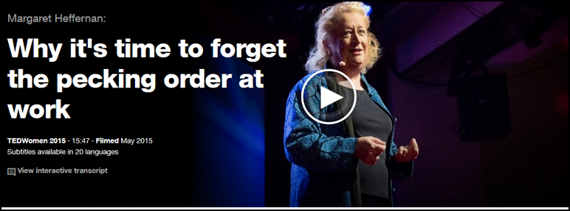
Successful Teams
https://www.ted.com/talks/margaret_heffernan_why_it_s_time_to_forget_the_pecking_order_at_work?language=en
Notes:
Refer to LEAP training resource materials.

Slide 71
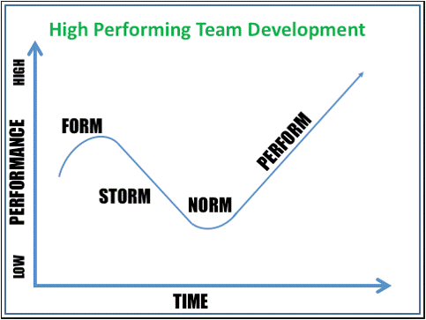
Tuckman Model

Slide 72
Phases of Team Development
Forming
Storming
Dissatisfaction
Norming
Resolution
Orientation
High expectations
Polite and cautious behavior
Some anxiety
Control
Competency questioned
Authority challenged
Power struggle
Listening
Problem Solving
Negotiation of norms and expectations
Objectives clarified
Performing
Production
Working collaboratively
Interdependent
Camaraderie
Trust
Notes:
Refer to LEAP training resource materials.
Take the teamwork survey and discuss results and share insights.

Slide 73
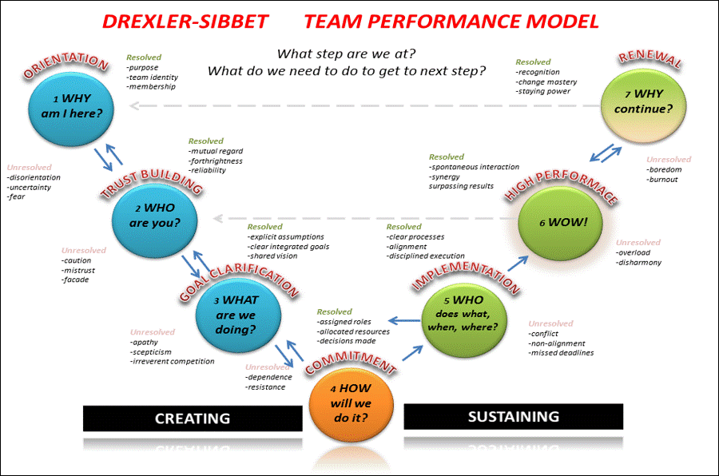
Drexler/Sibbet Team Performance Model

Slide 74
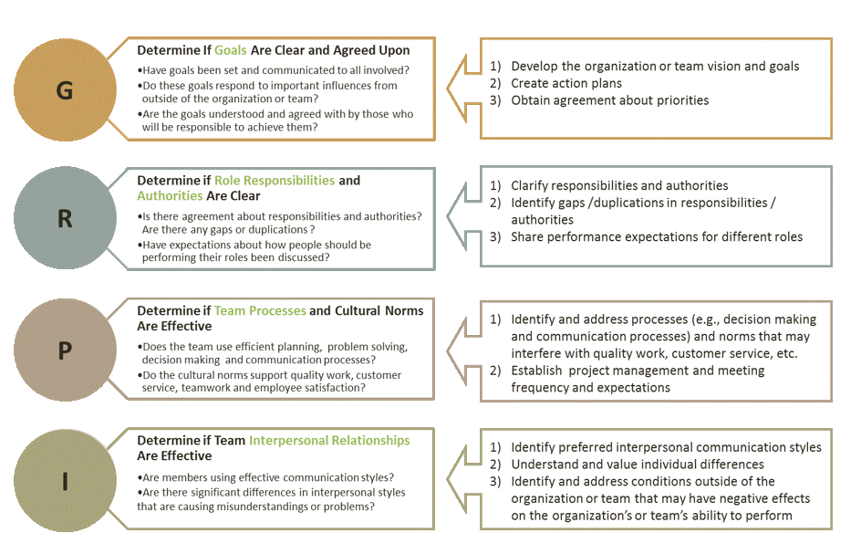
GRPI Model
Notes:
GRPI is used to ensure practitioners gauge the factors critical to team development in a structured way-and act on these factors throughout the project. Teams and organizations can be viewed through GRPI based on four fundamental dimensions:
Goals: Are the mission and goals of the team clear and accepted by all members? Are they in tune with the team’s environment?
Roles and Responsibilities: Are the roles and responsibilities clearly described and understood? Do the defined roles fully support the team goals?
Process and Procedures: Are there processes and procedures operating in the group (such as problem-solving methods, communication procedures, decision-making processes, etc) that are 1) understood and acceptable and 2) supportive to the group’s goals and roles?
Interpersonal relationships: Are the relationship among team members healthy and supportive of good team work? Is there an appropriate level of trust , openness and acceptance in the group? The I of GRPI is a function of the G, R, and P. In order to achieve I, there are two important items to keep in mind: 1) effective communication and 2) conflict avoidance and resolution.

Slide 75
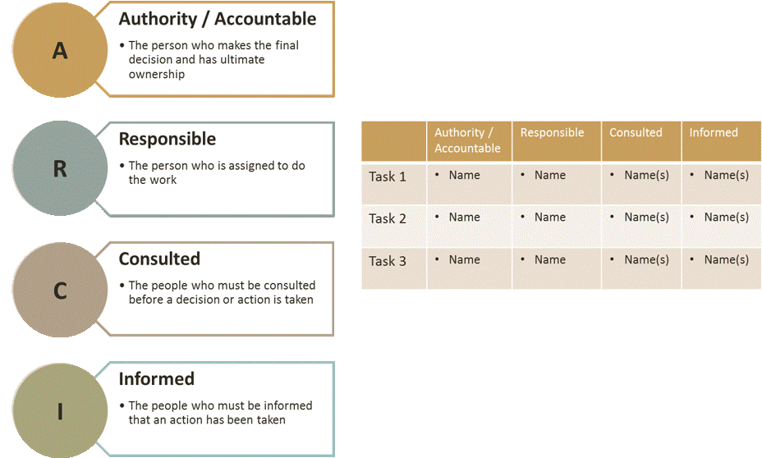
ARCI Model
Notes:
The ARCI Matrix is a responsibility assignment system that brings structure and clarity to the roles people play within a team. It is a simple grid system that you can use to clarify people’s responsibilities and ensure that everything that team needs to do is taken care of.
Benefits of Using ARCI
Many factors can contribute to the underperformance of a team, but unless responsibilities and accountabilities are clear, there can be a significant risk that problems will arise.
With complex, time-sensitive or mission-critical projects, or in situations where people are ducking responsibility, it is often worth taking the time to think through the roles that you and your team members must play in every task that your team undertakes. Without this clarity, you will most-likely find gaps, duplication and confusion. Teamwork will be frustrating, inefficient and you are less likely to deliver good results. In these situations, the delegation of tasks and other responsibilities can be too important to leave to chance.
One of the biggest challenges of team working (particularly in areas where there’s little margin for error) is to make sure everything is done completely and well. By taking a structured approach to role assignment using the ARCI Matrix, you can plot and check who is responsible and accountable for each team task, and also check the integrity of each person’s roles. In so doing, you can minimize the risk of gaps, overlaps and have a greater chance of running a highly effective and efficient team.

Slide 76
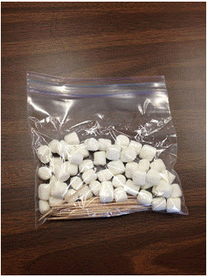
Group Exercise - ”Team Tower”
Build the tallest freestanding structure possible
Use only gumdrops and toothpicks
Ten minutes to complete
Notes:
Each team debriefs the activity with the entire group. The debrief should consist of the challenges and successes that occurred during the debriefs.

Slide 77
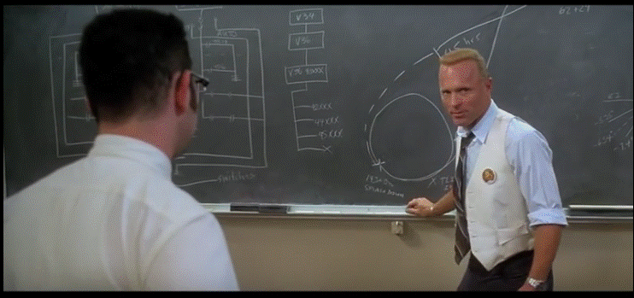
Leading Teams Effectively
https://www.youtube.com/watch?v=KhoXFVQsIxw
Notes:
Activity (watch the video to answer):
What leadership attributes did Gene Kranz demonstrate? What did he say and do that helped the team achieve success?
How did Kranz go about making key decisions during the crises? Describe the strengths of his decision making.
What did Kranz do in preparation to build team commitment and capability?
What lessons might apply to your leadership role in building and sustaining high performing work teams?
Be prepared to share your top leadership lesson to apply

Slide 78
Questions?

Slide 79

Topic 5:
Crucial Conversations
Notes:
Refer to LEAP training resource materials.

Slide 80
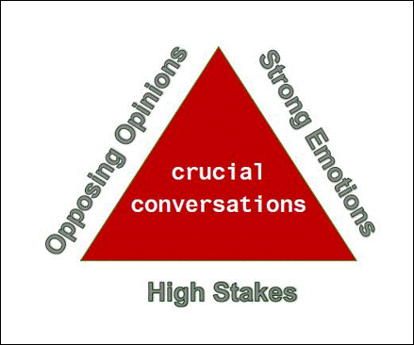
Three Elements of a Crucial Conversation
Notes:
Crucial conversations are not about getting everyone to agree – but making it safe to disagree.
The law of crucial conversations
Anytime you find yourself stuck, there are crucial conversations keeping you there. Identify the crucial conversations your are not holding or not holding well, figure out where you are going wrong, fix it and get better at everything.

Slide 81
Mastering Crucial Conversations
We can avoid them.
We can face them and handle them poorly.
We can face them and handle them well.
Notes:
A crucial conversation is a discussion between two or more people where stakes are high, opinions vary, and emotions run strong. When we face crucial conversations, we can do one of three things: We can avoid them, we can face them and handle them poorly, or we can face them and handle them well. Ironically, the more crucial the conversation, the less likely we are to handle it well. We often hold things inside by going silent until we cannot take it any longer—and then we drop a bomb. In short, we move between silence and violence—we either don’t handle the conversation, or don’t handle it well. We may not become physically violent, but we do attack others’ ideas and feelings. When we fail a crucial conversation, every aspect of our lives can be affected—from our careers, to our communities, to our relationships, to our personal health.

Slide 82
Difficult Conversations: 9 Common Mistakes
Review the Harvard Business Review Article
https://hbr.org/2010/10/difficult-conversations-9-common-mistakes
Notes:
Reading material for the group to discuss.
Key points in the articles:
Mistake # 1: We fall into a combat mentality: “When difficult conversations turn toxic, it’s often because we’ve made a key mistake: we’ve fallen into a combat mentality. This allows the conversation to become a zero-sum game, with a winner and a loser. But the reality is, when we let conversations take on this tenor – especially at the office – everyone looks bad, and everyone loses. The real enemy is not your conversational counterpart, but the combat mentality itself. And you can defeat it, with strategy and skill”
Mistake # 2: We try to oversimplify the problem: “If the subject of your argument were straightforward, chances are you wouldn’t be arguing about it. Because it’s daunting to try and tackle several issues at once, we may try to roll these problems up into a less-complex Über-Problem. But the existence of such a beast is often an illusion. To avoid oversimplifying, remind yourself that if the issue weren’t complicated, it probably wouldn’t be so hard to talk about.”
Mistake # 3: “We don’t bring enough respect to the conversation: “The key to avoiding oversimplification is respecting the problem you’re trying to resolve. To avoid the combat mentality, you need to go further – you need to respect the person you’re talking to, and you need to respect yourself. Making sure that you respond in a way you can later be proud of will prevent you from being thrown off course if your counterpart is being openly hostile.”
Mistake # 4: We lash out-or shut down. “Fear, anger, embarrassment, defensiveness – any number of unpleasant feelings can course through us during a conversation we’d rather not have. Some of us react by confronting our counterpart more aggressively; others, by rushing to smooth things over. We might even see-saw between both counterproductive poles. Instead, move to the middle: state what you really want. The tough emotions won’t evaporate. but with practice, you will learn to focus on the outcome you want in spite of them.”
Mistake # 5: We react to thwarting ploys. “Lying, threatening, stonewalling, crying, sarcasm, shouting, silence, accusing, taking offense: tough talks can present an arsenal of thwarting ploys. (Just because you’re trying to move beyond the combat mentality doesn’t mean your counterpart is.) But you also have an array of potential responses, ranging from passive to aggressive. Again, the most effective is to move to the middle: disarm the ploy by addressing it. For instance, if your counterpart has stopped responding to you, you can simply say, “I don’t know how to interpret your silence.”
Mistake # 6: “Everyone has a weak spot. And when someone finds ours – whether inadvertently, with a stray arrow, or because he is hoping to hurt us – it becomes even harder to stay out of the combat mentality. Maybe yours is tied to your job – you feel like your department doesn’t get the respect it deserves. Or maybe it’s more personal. But whatever it is, take the time to learn what hooks you. Just knowing where you’re vulnerable will help you stay in control when someone pokes you there.”
Mistake # 7: We rehearse: “If we’re sure a conversation is going to be tough, it’s instinctive to rehearse what we’ll say. But a difficult conversation is not a performance, with an actor and an audience. Once you’ve started the discussion, your counterpart could react in any number of ways – and having a “script” in mind will hamper your ability to listen effectively and react accordingly. Instead, prepare by asking yourself: 1. What is the problem? 2. What would my counterpart say the problem is? 3. What’s my preferred outcome? 4. What’s my preferred working relationship with my counterpart? You can also ask the other person to do the same in advance of your meeting.”
Mistake # 8: We make assumptions about our counterpart’s intention: “Optimists tend to assume that every disagreement is just a misunderstanding between two well-intentioned people; pessimists may feel that differences of opinion are actually ill-intentioned attacks. In the fog of a hard talk, we tend to forget that we don’t have access to anyone’s intentions but our own. Remember that you and your counterpart are both dealing with this ambiguity. If you get stuck, a handy phrase to remember is, “I’m realizing as we talk that I don’t fully understand how you see this problem.” Admitting what you don’t know can be a powerful way to get a conversation back on track. “
Mistake # 9: We lose sight of the goal: The key in any tough talk is to always keep sight of the goal. Help prevent this by going into conversations with a clear, realistic preferred outcome; the knowledge of how you want your working relationship with your counterpart to be; and having done some careful thinking about any obstacles that could interfere with either. (Remember, “winning” is not a realistic outcome, since your counterpart is unlikely to accept an outcome of “losing.”)

Slide 83
Step-by-Step Checklist for Difficult Conversations
How to Prepare for Crucial Conversations
https://www.judyringer.com/resources/articles/we-have-to-talk-a-stepbystep-checklist-for-difficult-conversations.php
Notes:
Reading material for the group to discuss.
Keypoints:
Before going into the conversation, ask yourself some questions:
What is your purpose for having the conversation? What do you hope to accomplish? What would be an ideal outcome? Watch for hidden purposes. You may think you have honorable goals, like educating an employee or increasing connection with your teen, only to notice that your language is excessively critical or condescending. You think you want to support, but you end up punishing. Some purposes are more useful than others. Work on yourself so that you enter the conversation with a supportive purpose.
What assumptions are you making about this person’s intentions? You may feel intimidated, belittled, ignored, disrespected, or marginalized, but be cautious about assuming that this was the speaker's intention. Impact does not necessarily equal intent.
What “buttons” of yours are being pushed? Are you more emotional than the situation warrants? Take a look at your “backstory,” as they say in the movies. What personal history is being triggered? You may still have the conversation, but you’ll go into it knowing that some of the heightened emotional state has to do with you.
How is your attitude toward the conversation influencing your perception of it? If you think this is going to be horribly difficult, it probably will be. If you truly believe that whatever happens, some good will come of it, that will likely be the case. Try to adjust your attitude for maximum effectiveness.
Who is the opponent? What might he be thinking about this situation? Is he aware of the problem? If so, how do you think he perceives it? What are his needs and fears? What solution do you think he would suggest? Begin to reframe the opponent as partner.
What are your needs and fears? Are there any common concerns? Could there be?
How have you contributed to the problem? How has the other person?

Slide 84
Crucial Conversations Exercise
Select a partner
Directly Face one Another…select opposites of a topic and Go!
Debrief
Notes:
Topics Included are as follows:
Providing Feedback on a person poor job performance
Moving to across the country for a job opportunity.
Contract Award Decision

Slide 85
Questions?

Slide 86

Topic 6: Skills for Managing & Motivating Staff at All Levels to Perform & Contribute to an Organization
Notes:
LEAP Session 3 Managing and Motivating Others

Slide 87
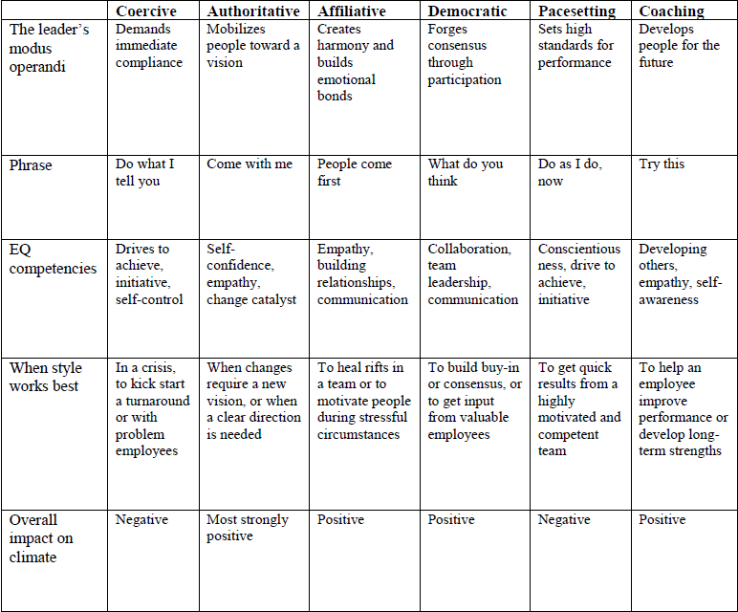
Traits for Managing & Motivating Others Six Leadership Styles at a Glance
Notes:
Optional group exercise: Pick 5 people who excel/excelled at managing and motivating others. List the qualities that make / made them effective. Decide by voting the ten most important characteristics of people / leaders who can manage and motivate others.
Refer to LEAP training resource materials.

Slide 88
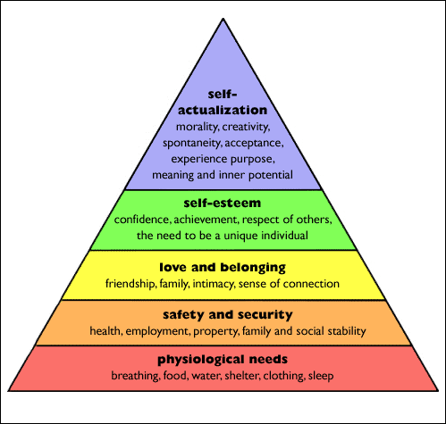
Maslow’s Hierarchy of Needs
Notes:
Refer to LEAP training resource materials.

Slide 89

But how do I motivate those around me?

Slide 90

Encourage the Heart*
Expect the Best
Show them you believe; set clear
goals/rules; give regular feedback
Personalize Recognition
Get close to people; be creative about
incentives; just say “thanks”
Create a Spirit of Community
Celebrate accomplishments; provide social support; invest in “fun”
Be Personally Involved
Show you care; spread the stories; make celebrations part of the culture
Notes:
Refer to LEAP training resource materials.

Slide 91
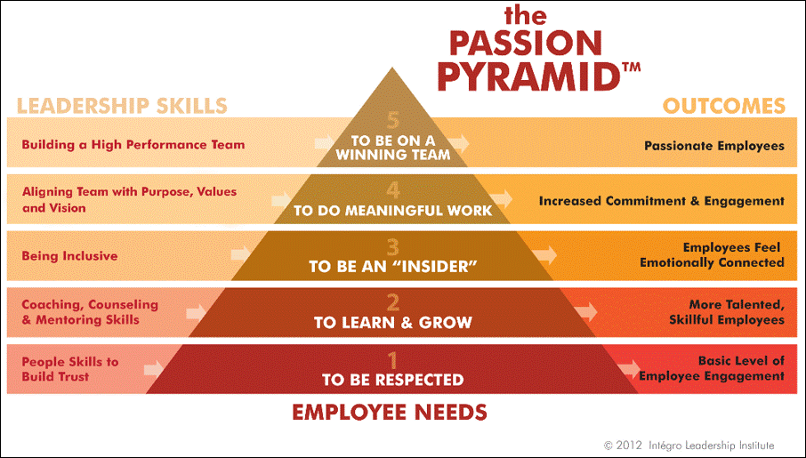
Encourage the Heart*
Notes:
Refer to LEAP training resource materials.

Slide 92
What keeps you where you are?
Employees are motivated by different factors. This means that individuals require individualized engagement strategies.
What keeps you in your present position?
What might entice you to leave?
What is most energizing about your work?
Are your talents being fully utilized?
What could your organization do to help you be more successful?
Notes:
Answer these questions to determine what keeps you in your present job.
Refer to LEAP training resource materials.

Slide 93


Why Most People Stay?*
1. Exciting work and challenge
2. Career growth, learning and development
3. Working with great people
4. Fair pay
5. Supportive management/good boss
6. Being recognized, valued, and respected
7. Benefits
8. Meaningful work and making a difference
9. Pride in the organization, its mission, and its product
10. Great work environment and culture
11. Autonomy, creativity and sense of control
12. Flexibility: work hours, dress and so on
13. Location
14. Job security and stability
15. Diverse, changing work assignments
16. Fun on the job
17. Being part of a team
18. Responsibility
19. Loyalty, commitment to the organization or coworkers
20. Inspiring leadership
Notes:
Compare your answers with the top 20 responses listed in order of frequency from 17,000 respondents.
Refer to LEAP training resource materials.

Slide 94

Most Effective Motivators for Today’s Workplace
Autonomy – our desire to be self-directed
Mastery – our urge to get better and be better at what we do
Purpose – our desire to be part of something larger than ourselves
Notes:
Refer to LEAP training resource materials.

Slide 95
Employee Engagement
Engagement is the extent to which employees commit to something or someone in their organization and how hard they work and how long they stay as a result of that commitment.
Notes:
Corporate Leadership Council, Driving Performance and Retention Through Employee Engagement: A Quantitative Analysis of Effective Engagement Strategies, http://cwfl.usc.edu/assets/pdf/Employee%20engagement.pdf, Washington, D.C. 2004

Slide 96
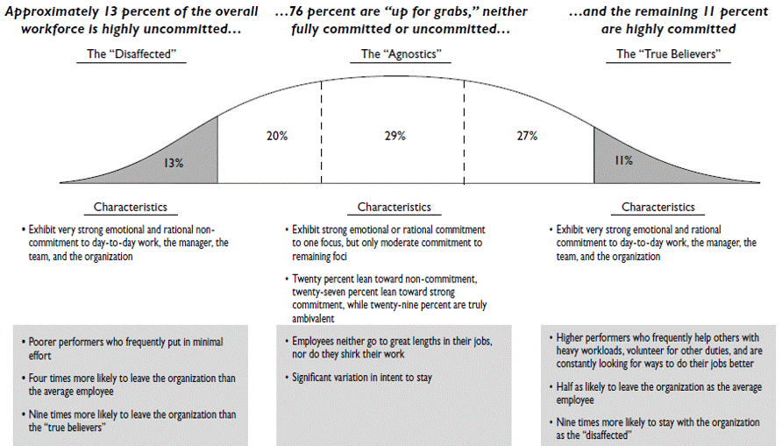
Employee Engagement
A recent state of employee engagement:
Notes:
Only 11% of employees are “highly engaged.” The real opportunity to improve organization performance lies in motivating the middle 76% who are modestly committed.
Corporate Leadership Council, Driving Performance and Retention Through Employee Engagement: A Quantitative Analysis of Effective Engagement Strategies, http://cwfl.usc.edu/assets/pdf/Employee%20engagement.pdf

Slide 97
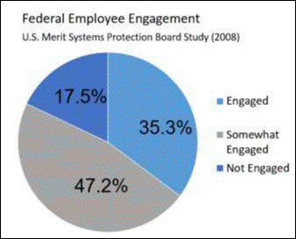
Employee Engagement
Notes:
Discuss application of engagement in the Federal workforce.
Refer to LEAP training resource materials.

Slide 98

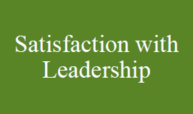


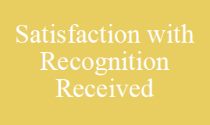
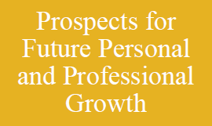
6 Drivers of Engagement*
Notes:
Refer to LEAP training resource materials.
Note on 5th Driver: To be effective, recognition needs to be tied to specific performance results and be given only to employees who truly have earned it; i.e., those who have clearly met the criteria for the award.

Slide 99
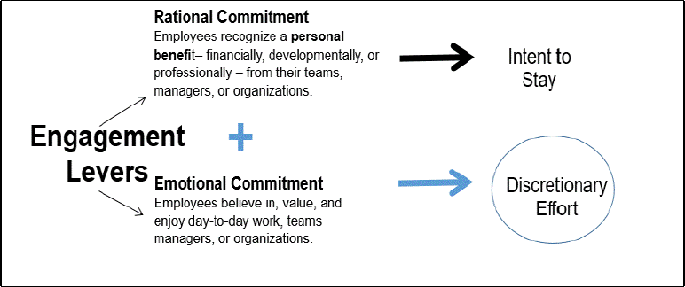
A Model of Engagement
Notes:
Engaged employees are not only satisfied in their job, but they also 1) Find personal meaning in their work, 2) Take pride in what they do and where they do it, and 3) Have the feeling that their organization values them.
The greater the employee’s engagement, the more likely they are to go above and beyond the minimum required to improve their own and in turn the organization’s performance.

Slide 100
Top 12 Actions to Engage Employees
Ensure employees know their work is important and articulate how it fits into the overall mission of the organization
Fight for resources to help employees do their jobs
Align employee roles with strengths
Provide praise and recognition at least once a week
Express concern for your employee as a person
Actively encourage employee career development
Listen to their opinions, and create a team culture where opinions are voiced and heard
Ensure that the mission/purpose of the organization makes employees feel their work is important
Ensure all team members do quality work and are held accountable
Build relationships among employees
Give feedback on progress frequently, at least every six months
Provide development experiences
Notes:
Refer to LEAP training resource materials.

Slide 101

Federal Employee Engagement Improvement Index Items
LEADERS: Employees’ perceptions of the integrity of leadership, as well as leadership behaviors such as communication and workforce motivation.
Generate high levels of motivation and commitment in the workforce
Maintain high standards of honesty and integrity
Communicate the goals and priorities of the organization
Improve upper management’s performance
Increase respect for an organization’s senior leaders
Notes:
Refer to LEAP training resource materials.
Instructor to ask learners for examples of each kind of engagement strategy they’ve seen in action or used themselves and how did they think the strategy worked?

Slide 102

Federal Employee Engagement Improvement Index Items
SUPERVISORS: The interpersonal relationship between worker and supervisor, including trust, respect, and support.
Support employees’ development
Listen to employees and treat them with respect
Generate trust and confidence
Improve immediate supervisors’ performance
Notes:
Refer to LEAP training resource materials.

Slide 103

Federal Employee Engagement Improvement Index Items
INTRINSIC WORK EXPERIENCE: Employees’ feelings of motivation and competency relating to their role in the workplace.
Encourage innovation among employees
Make employees feel personally accomplished by their work
Set clear job expectations
Use employee talents appropriately
Convey how the work relates to the agency’s goals and priorities
Notes:
Refer to LEAP training resource materials.

Slide 104
Questions?

Slide 105

Topic 7: Leveraging Individual Differences to Maximize Performance
Notes:
LEAP Session 3 Managing and Motivating Others

Slide 106
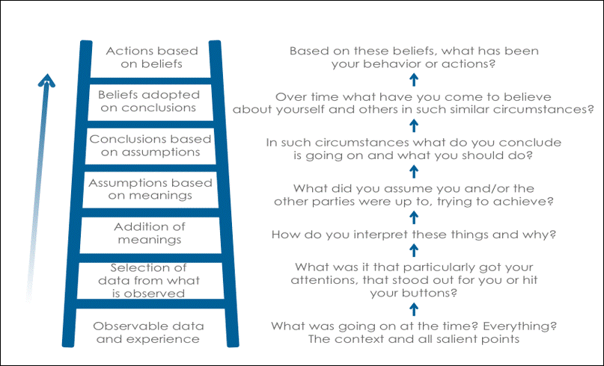
Ladder of Inference
Notes:
The “Ladder of Inference” describes the thinking process we go through (without realizing it) to get from a fact to a decision or action. The thinking stages can be thought of as rungs on a ladder. It is how we draw conclusions to an event. Refer to LEAP training resource materials.

Slide 107
Making Differences Matter
Leadership must:
Understand a diverse workforce embodies different perspectives and approaches to work, and must truly value variety of opinion and insight
Recognize both the learning opportunities and the challenges that different perspectives presents for an organization
Organization Culture must:
Create an expectation of high standards of performance from everyone
Stimulate personal development
Encourage openness
Culture must make workers feel valued
Organization must have a well-articulated and widely understood mission
Notes:
Refer to LEAP training resource materials.

Slide 108
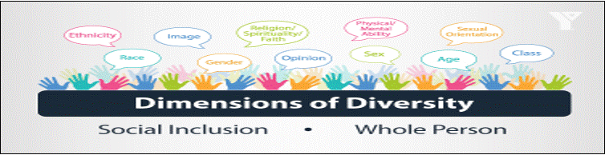
Dimensions of Diversity
Primary & Secondary Dimensions
We understand the world around us through filters
Our ability to see things “objectively” depends on experiences & influence
Notes:
Refer to LEAP training resource materials.

Slide 109
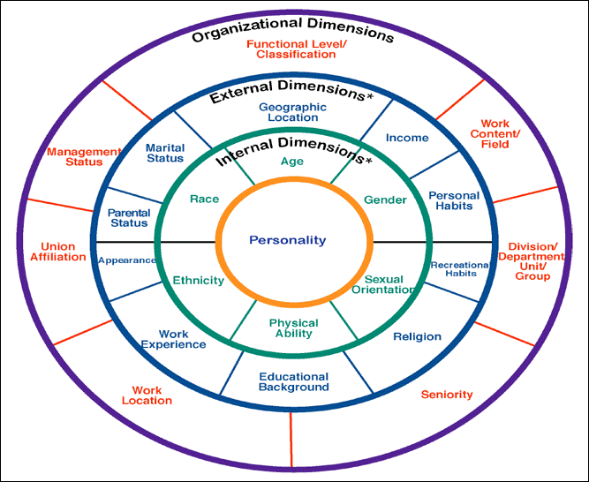
Dimensions of Diversity
Notes:
Refer to LEAP training resource materials.

Slide 110

Belonging
Do I experience ways in which I do not feel I belong in my workplace? If so, how and why? If not, why?
How might others be experiencing situations where they might not feel they belong on my workplace?
What can I do to enhance the experience of belonging and inclusion for everyone in my workplace?
How can I continue to expand my appreciation of people that are not like me?
Notes:
Refer to LEAP training resource materials.

Slide 111
Belonging Exercise
Similarities & Differences:
Notes:
Refer to LEAP training resource materials.
Each person should identify four things about themselves that are different than the other two parties and list them in one of the dotted circles.
Then, the group should identify four characteristics they share in common and list them in the circle with a completed line.
Explain to your partners the factors you have included and how you think they impact your view of yourself, of others and of the world around you.

Slide 112
Harvard Business Review Article: Diversity Efforts
Notes:
Diversity Efforts Fall Short Unless Employees Feel That They Belong by Pat Wadors
Six ways to create a “belonging moment” for someone and help instill a culture of belonging and inclusiveness:
Make introductions
Ask
Solicit input in meetings
Delegate
Pay attention
Share stories

Slide 113
Generational Differences
Vets (before 1947)
Baby Boomers (1947-1965)
Generation X (1965-1980)
Millennials (1980-2000)
Notes:
Refer to LEAP training resource materials.

Slide 114
Generational Differences
What are your attitudes, beliefs and/or values concerning:
Communication
Technology
Work and workplace expectations
Loyalty

Slide 115
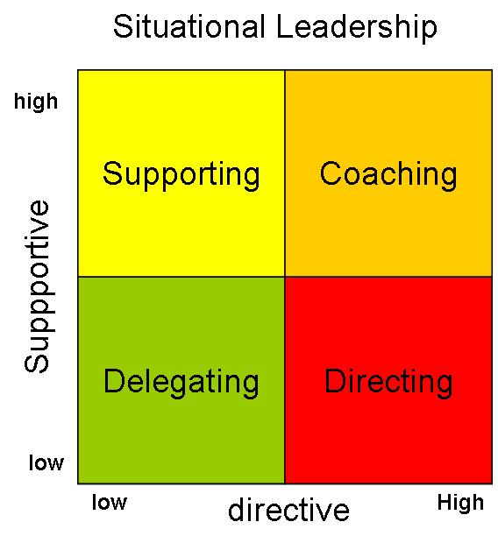
Situational Leadership
Adjusting the leadership style for the situation at hand
Notes:
Refer to LEAP training resource materials.

Slide 116
Situational Leadership
Key to Remember: Both task and people are important
Requires three basic skills
Be Flexible
Assess the needs of the individual and/or group
Communicate – Be open and honest about which style works in any given situation

Slide 117
Situational Leadership
Styles
Directing - One way communication
Action
Structure
Control
Supervise
Coaching - Two way communication
Supportive
Listen
Praise
Facilitate

Slide 118
Questions?

Slide 119

Topic 8: Driving Innovation

Slide 120
Innovation Definition
Innovation
n. The process of improving, adapting or
developing a product, system or service to deliver better
results and create value for people.
Innovation Leadership
n. The practice of cultivating an environment where
improvement, adaptation and invention are encouraged,
fostered and rewarded.
Sequential Process
• Identifying problems, needs or opportunities
• Generating ideas
• Moving the best idea to completion
• Generating value from those ideas
Creativity is a skill • Innovation is a process

Slide 121
How to Innovate?
Improve something you already do to deepen impact
Simplify a core business process, redesign your customer service systems or make information and programs more accessible through online services
Adapt a tried and true idea to a new context
Benchmark – borrow great ideas or catalyze the adoption of proven ideas
Develop something entirely new to achieve goals
This may be a new service, process, policy or tool
Notes:
Refer to LEAP training resource materials.

Slide 122
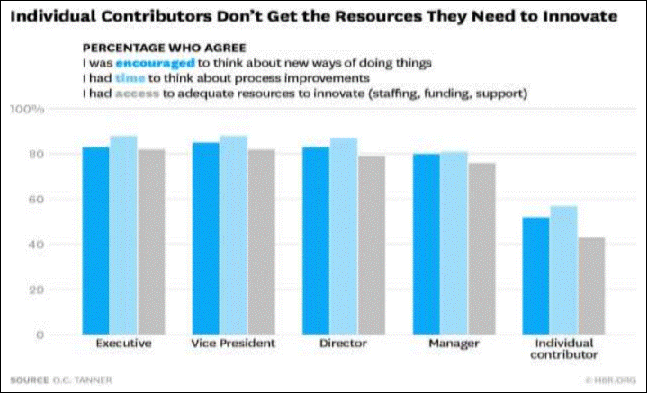
Why is Innovation Difficult?
Creativity = Time + Resources
Notes:
Refer to LEAP training resource materials.

Slide 123

Barriers to Innovation
Delivery pressures and administrative burdens
Lack of resources, technology, and tools (e.g., knowledge sharing)
Low tolerance for risk
Restrictive rules
Poor collaboration and management skills
Insufficient rewards and encouragement
What else?
Notes:
Refer to LEAP training resource materials.
Source: How Statistics Canada Encourages Innovation Case Study, May 2010

Slide 124
Government Innovation
89.8 percent of government employees said they are constantly looking for ways to do their jobs better, but only
32.7 percent believe creativity and innovation are rewarded in their organization, and just
54.1 percent feel encouraged to come up with new ways to do their work
Notes:
Refer to LEAP training resource materials.
Source: PPS 2014 Best Places to Work Government Innovation Score

Slide 125
Are You Right-Brained or Left-Brained?
Notes:
Refer to LEAP training resource materials.
www.thepremiertutors.org

Slide 126
Whole Brain Thinking
So why do you want to use your “whole brain”?
The innovative process is in fact a process. Innovation and creativity have been referred to as novel associations that are useful. To create novel associations we must break free from the binary framework that typically locks us into focusing on information we already know or assume to be true. The goal is to improve your ability to move laterally across different categories of thought that may be opposite to the way we typically think. Rather than going deep, we want you to move across various ways of thinking. Using various ways of thinking can lead to better solutions to the same problems!.
How do you challenge yourself to break patterns and not just do what comes easy?
Notes:
Refer to LEAP training resource materials.
Exercise: Write with your non-dominant hand what the experience is like of writing with your non-dominant hand? As you were writing with your non-dominant hand you were challenging your brain to break the patterns established very early in life. The additional thought required to accomplish the task can help develop your brain.

Slide 127

What Enhances Creativity?
Distracting / disengaging areas of our brain responsible for decision making
Engaging parts of our brain responsible for association, context, events, and emotional responses
Entering a relaxed state of mind
Increasing dopamine (our motivation molecule) which increases brain activity and connections
Notes:
Refer to LEAP training resource materials.
Source: https://blog.bufferapp.com/why-we-have-our-best-ideas-in-the-shower-the-science-of-creativity
Why is a relaxed state of mind so important for creative insights? When our minds are at ease–when those alpha waves are rippling through the brain–we’re more likely to direct the spotlight of attention inward, toward that stream of remote associations emanating from the right hemisphere. In contrast, when we are diligently focused, our attention tends to be directed outward, toward the details of the problems we’re trying to solve. While this pattern of attention is necessary when solving problems analytically, it actually prevents us from detecting the connections that lead to insights.

Slide 128

“Little Bets” by Peter Sims
Experiment
Play
Immerse
Define
Reorient
Iterate
INNOVATIVE LEADERS ARE…
Resilient
Visionary and Self-Aware
Politically Savvy
Supportive
Notes:
Refer to LEAP training resource materials. Source: Little Bets, Peter Sims
Experiment: learn by doing and fail quickly to learn fast.
Play: provide a playful and improvisational atmosphere to prevent creative ideas from being snuffed out or prematurely judged.
Immerse: gather fresh ideas and insights, and understand deeper motivations – absorb how things work from the ground up.
Define: use insights gathered throughout the process to define specific problems and needs before solving them.
Reorient: be flexible in pursuit of larger goals and aspirations, making good use of small wins to make necessary pivots and chart the course to completion.
Iterate: repeat, refine, and test frequently armed with better insights, information, and assumptions as time goes on.
INNOVATIVE LEADERS ARE… • not impeded by structural, procedural, cultural or political barriers - they don't give up • Constantly broadening their perspective • understand and know how to navigate through and around their organization's structure, culture and politics • understand and respect the roles, boundaries and agendas of other governmental organizations • purposefully leverage networks and relationships, and use complex influencing skills to collaborate across organizational boundaries • build strong, diverse teams through their leadership, creating a sense of purpose, fostering a climate that facilitates innovation and developing others as an essential part of their job

Slide 129
Create the Conditions
Create an environment in which each of these conditions thrives:
Create recognition programs for employees’ innovative accomplishments
Establish an internal group that helps employees test ideas and navigate bureaucracy
Start a program that brings in outside thinkers to help solve agency challenges
Promote learning and coordination between business units or program offices
Provide a forum for employees to collaborate and share creative ideas
Notes:
Refer to LEAP training resource materials.

Slide 130
Create the Conditions – Additional Ideas
See acquisition as a strategic partner/consultant
Interest-based negotiation – instill the mindset of getting to yes
Create a culture where innovation is encouraged and failure is acknowledged as an acceptable aspect to trying things
Create a list of tools and resources to draw from that assist in tackling issues innovatively
Systems Thinking – increase awareness of all functional areas (other areas within Finance in addition to IT, HR, etc.) and impact of each on the other
Notes:
Refer to LEAP training resource materials.
See acquisition as a strategic partner/consultant:
• See the big picture and understand agency and program goals
• Have processes in place with stakeholders, customers etc. to work more effectively
• Work with programs, view those teams as clients and providing acquisition expertise
• Increase strong communication, facilitation and customer service skills
Interest-based negotiation – instill the mindset of getting to yes. Create a culture where innovation is encouraged and failure is acknowledged as an acceptable aspect to trying things
• Needs to be supported by senior leadership
• Incorporate innovation concepts into training
Create a list of tools and resources to draw from that assist in tackling issues innovatively
Systems Thinking – increase awareness of all functional areas (other areas within Finance in addition to IT, HR, etc.) and impact of each on the other

Slide 131
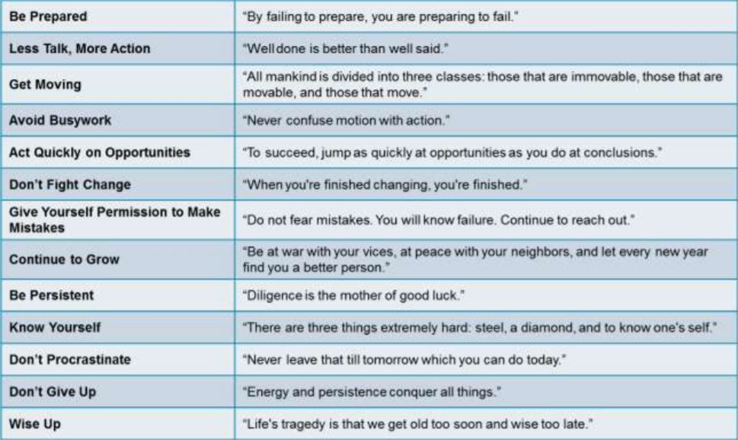
Innovative Wisdom – Source Benjamin Franklin
Notes:
Refer to LEAP training resource materials.

Slide 132
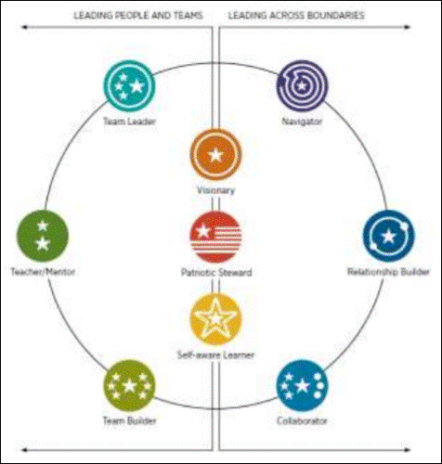
Innovative Leaders
Notes:
Refer to LEAP training resource materials.

Slide 133
Innovative Leaders Self-Assessment
Notes:
Refer to LEAP training resource materials.
Review the table attached and circle the level of leadership that you feel you are at for each leadership attribute.
• Areas where you are particularly strong or areas to work on improving

Slide 134
More on Innovation
4 Key Principles of Powerful Collaborative Innovation
“Yes, and…”
“If, then…”
My Partner is a Genius!
There are No Mistakes
Brainstorming
A technique for using a group of people to stimulate the production of ideas
Innovative Caution!
Serial processing
Social loafing
Groupthink
Notes:
Refer to LEAP training resource materials.
Brainstorming Exercise – identify a topic specific to your workplace (ex. improvements for workforce morale)
Go around the table and come up with as many ideas as possible … make a list as you go
o Quantity not quality
INNOVATION CAUTION!
Serial processing – be wary of setting up a process where only one person can speak at a time
• Social loafing – when groups work together, some individuals may put forward less effort (assuming others will pick up the slack)
• Groupthink – early ideas can influence the thinking of other contributors, potentially narrowing the set of ideas that are generated

Slide 135
15 Ways to Jump Start Your Creativity
One-a-Day
Brainstorming Board
Idea Lottery
Creative Corner
Take A Thought Walk
Let’s Do Lunch
Bright Ideas Notebook
Creativity By Committee
Hall Of Fame
Left And Right Brains
Idea Quotas
Ticket Of Admission
Change “Yes, but…” to “Yes, and...”
Three Ways
Fresh Eyes
Notes:
Refer to LEAP training resource materials.
Source: Adapted from Michael Michalko http://creativethinking.net/#sthash.vDYUVHJh.dpuf
1.ONE-A-DAY. Ask each person to try to improve one aspect of their job each day, focusing on the areas within their control. At the end of the day, people should meet and ask each other what they did differently and better than it was the day before. 2. BRAINSTORMING BOARD. Put up a bulletin board in a central area and encourage people to use it to brainstorm ideas. Write a theme or problem on a colored card and place it in the center of the board. Provide pieces of white paper on which people can write their ideas to post on the board. E.g. suppose you have difficulty performing a particular task. You could describe the task on a colored card, post it on the brainstorming board and ask people to post their ideas and suggestions. 3. IDEA LOTTERY. Have a monthly “idea lottery,” using a roll of numbered tickets. Each time a person comes up with a creative idea, he or she receives a ticket. At the end of each month, share the ideas with the staff and then draw a number from a bowl. If the number on anyone’s ticket corresponds to the number drawn, he or she gets a prize. If no one wins, double the prize for the next month. 4. CREATIVE CORNER. Provide a special area for people to engage in creative thinking. Stock the area with books, videos on creativity, as well as learning games. 5. TAKE A THOUGHT WALK. Look for interesting objects, situations, or events that are interesting or that can be metaphorically compared with whatever project you happen to be working on. Ask hypothetical questions based on objects or situations you notice, such as: • How is this like my problem? • What if my problem were a…? What are the similarities? • This….is like the solution to my problem because…? • How is …like an idea that might solve my problem? 6. LET’S DO LUNCH. Encourage weekly lunch-time meeting of three to five employees to engage in creative thinking. Ask meeting participants to read a book on creativity; each person can read a different chapter and share ways of applying creative thinking to the organization. Invite creative people from the community to speak to the group and ask them for ideas on how to become more creative in your organization. 7. BRIGHT IDEAS NOTEBOOK. Present each person with a “Bright Idea Notebook,” and ask everyone to write one or two ideas in the notebook every day for one month on how to improve your organization. At the end of the month, collect all the notebooks and categorize the ideas for further discussion. 8. CREATIVITY BY COMMITTEE. Establish a “creative-idea” committee made up of volunteers. The goals of the committee should be to elicit, discuss, and implement employee’s ideas. The committee can record the number of ideas on a thermometer-type graph. The organization can recognize and reward people according to the quantity, quality, and impact of their creative contributions. 9. HALL OF FAME. Turn an office hallway into an Employee Hall of Fame. Post photographs of those whose ideas are implemented along with a paragraph about the person, the idea, and its impact on the company. 10. LEFT AND RIGHT BRAINS. When brainstorming in a group, try dividing the group into left-brain (rational) thinkers and right-brain (intuitive) thinkers. Ask the left-brainers to come up with practical, conventional and logical ideas; ask the right-brainers to come up with far-out, unconventional and nonlogical ideas. Then combine the groups and share the ideas. 19 11. IDEA QUOTAS. Thomas Edison guaranteed productivity by giving himself and his assistants idea quotas. His own personal quota was one minor invention every 10 days and a major invention every six months. A way to guarantee creativity is to give each employee an idea quota of a new idea a week. 12. TICKET OF ADMISSION. Require everyone to bring one new idea as their ticket of admission to any group meeting. The idea should focus on some aspect of their job and how they can improve what they do. 13. CHANGE “YES, BUT…” to “YES, AND..” Someone offers an idea in a meeting, and many of us are tempted to say “Yes, but…” To change this mind set, whenever someone says “Yes, but…” require the person to change “Yes, but…” to “Yes, and…” and continue where the last person left off. 14. THREE WAYS. Employees shouldn’t waste time thinking of reasons why something can’t work or can’t be done. Instead, they should think about ways to make something work, and then get it done. Ask employees to think of three job-related goals, targets, or tasks they think can’t be accomplished. Then ask them to figure out three ways to accomplish each of them. Then do the same thing yourself. 15. FRESH EYES. Jonas Salk, developer of the vaccine that eradicated polio, made it a standard practice to assemble men and women from different domains to his group sessions. He felt this practice helped him bring out new ideas that could not arise in the minds of individuals who were from the same domain. Invite people from other departments to your brainstorming sessions and ask them how they would solve your problems. Lastly, don’t forget to thank people for their ideas. Design your own “Thank You for Your Great Idea” cards and distribute them freely to contributors. Ask the CEO to sign each card with a personal message. Stock up on instant lottery cards and include one or two in each card to show your appreciation.

Slide 136
Acquisition Innovation Application
HOW MIGHT WE be more
innovative in our day-to-day jobs?
Notes:
Refer to LEAP training resource materials.
How might we be more innovative in our day-to-day jobs? Table Group Brain writing then Brainstorming 1. Using brain writing, table groups will take 15 minutes to come up with as many ideas as possible for this challenge (you may use index cards or gallery walk) 2. Groups will then spend 5 minutes to determine their top idea that they would like to develop further 3. Using Little Bets and other innovation concepts, take 10 minutes to brainstorm, discuss, and identify 5 “little” things your table agrees on that would move this idea to fruition Groups will then spend ~ 3 minutes reporting out on their conversations, the process and the results

Slide 137
Articles:
Notes:
Innovation is a Contract Sport – Provide the learners time to read the article prior to discussing it as a group. Discuss ways to achieve innovative outcomes in acquisitions at your agency. How can you look for opportunities to innovative? Discuss the importance of strategic partnerships and ways of improving partners with industry, such as industry days. Review OFPP’s Acquisition 360 as a group to brainstorms ideas.
Innovation in Government: Provide the learners time to read the article prior to discussing it as a group. Specifically discuss ways to improve innovation in their organizations. Explore different areas that may benefit the learners and the organization to find new ways of improving what they do each day. Discuss the section in the article on “overcoming the barriers to innovation in government.” What are some of the barriers? How can the learners overcome barriers in their organization?

Slide 138
Questions?

Slide 139

Topic 9: Understanding the Dynamics of Power and Influence
Notes:
LEAP Session 5 Achieving Results

Slide 140
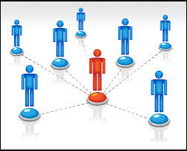
The Influence Model Understanding Your Audience What are the…
Individual and Project Goals
Needs
Motivators
Frustrations
Priorities
Style of Behavior
Platinum Rule:
“Treat others the way THEY want to be treated”
Notes:
LEAP Session 5 Achieving Results

Slide 141
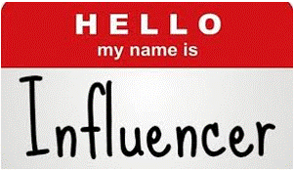
Influencing
Influence is… the ability to change or reinforce other’s attitudes, opinions or behaviors
Notes:
LEAP Session 5 Achieving Results

Slide 142
Personal and Positional Power
Personal: | Positional:
An individual’s power comes from an interrelated set of positional and personal characteristics. Not just based on formal authority or “charisma” | The source of power which prove to be most important are context dependent. e.g., Specific to your organization.
Notes:
LEAP Session 5 Achieving Results
Instructor to ask learners to give an example of each

Slide 143
Influencing Skills – Sources of Personal Power
Expertise | Relevant knowledge and skills
Track Record | Relevant experience (reputation, reliability, trust)
Attractiveness | Attributes that others find appealing, identify with, and admire (based on personal preference)
Effort | Expenditure of time and energy
Information | Access to data and ability to share information in a convincing way
Goodwill | Feelings of support and respect that the leader has built with others
Notes:
LEAP Session 5 Achieving Results

Slide 144
Influencing Skills – Sources of Positional Power
Formal Authority | Position in hierarchy and prescribed responsibilities
Relevance | Relationship between task and organizational (mission) objectives
Centrality | Position in key networks and access to resources
Autonomy | Amount of discretion in position
Visibility | Degree to watch performance can be seen by others
Reward | Control over things others desire
Notes:
LEAP Session 5 Achieving Results

Slide 145
Influencing Skills – Process and Techniques
Reflecting on the list of personal and positional sources of influence:
What are the top three sources of influence in your organization?
What are your top three sources of influence?
Exercise:
Pair up and take turns discussing:
What is one source of influence, that if you cultivated it, it would lead to a greater ability to influence others?
Notes:
LEAP Session 5 Achieving Results

Slide 146
Influencing Others
Why influence others?
Authority doesn’t always work; direct control over others is limited.
Your ability to influence is directly related to your individual success at work or in interpersonal relationships.
You need a well thought-out plan and then practice flexibility.
You must learn to work with others so that everyone’s goals are met.
Notes:
LEAP Session 5 Achieving Results

Slide 147
Influencing Without Authority
Cultivate a broad network
Use constructive persuasion and negotiation
Define and share a mutual purpose
Understand other perspectives and interests
Consult – ask for opinions and ideas
Build Coalitions
Whose buy-in is critical to your initiative's success?
Engage at the right time
Notes:
LEAP Session 5 Achieving Results

Slide 148
Factors in Any Influence Situation
What you want
Your Goal/What do I want?
What will make it clear to the other person?
What assumptions am I making about the person(s) I want to influence?
What they want
What is their mindset?
What’s important to them?
What’s going on in their organization (department) that might affect the situation?
Notes:
LEAP Session 5 Achieving Results

Slide 149
The Two Fundamental Factors in Action
Write down your influence goal. What do you want in this situation and what will make your needs clear to the other person? What assumptions are you making about the other person?
What are the main issues that are likely to emerge in this upcoming meeting (interpersonal, organizational)?
What are the top two or three issues that must be resolved by the end of this meeting?
What do you think is the other person’s point of view? What is important to them? What isn’t? What has worked with them before?
Notes:
LEAP Session 5 Achieving Results

Slide 150
Influencing Strategies
Technique | How to Use in Influencing | When to Use in Influencing
Push | State your position Get your point across “One way” type feeling Clear action, logical conclusion Clearly stated goals Assert what you want Suggest other concrete ways the other person can assist you | You know what you want You have good reasons for your positon You believe you need a direct approach
Notes:
LEAP Session 5 Achieving Results

Slide 151
Influencing Strategies
Technique | How to Use in Influencing | When to Use in Influencing
Pull | Draw out the other person Understand the other person’s position Create shared commitment Ask Questions Open-ended Focused questions – focusing on alternatives Summarize and feedback | You want to build or maintain a relationship You need commitment and involvement You need information
Notes:
LEAP Session 5 Achieving Results

Slide 152
Influencing Strategies
Technique | How to Use in Influencing | When to Use in Influencing
Push/Pull | Provide direction Promote agreement and commitment Offer incentives to make it easier for the other person to do what you want | You want breakthrough results You want meaningful dialogue
Notes:
LEAP Session 5 Achieving Results

Slide 153
Suggestions for Gaining Cooperation
1. Ask people to help, don’t demand
2. Promise to return a favor. Then do it.
3. Describe the problem objectively, avoid blaming or accusations.
4. Describe clearly why cooperation is important.
5. Clearly outline the benefits.
6. Define mutual benefits (outcomes) for the cooperation you are requesting.
Notes:
LEAP Session 5 Achieving Results

Slide 154
Suggestions for Gaining Cooperation
7. Ask for ideas for achieving desired results.
8. Negotiate agreements on specific actions to take.
9. Decide together what “success” is.
10. Listen and respond with empathy to concerns and needs.
11. Build support for your positions that can apply pressure on those who are not cooperative.
12. Offer your support when needed.
Notes:
LEAP Session 5 Achieving Results

Slide 155
Influencing Skills – Process and Techniques
Start with planning and stakeholder analysis
What behavior, attitude or value am I trying to affect?
Who am I trying to influence?
Harness peer pressure
Within the pool of people you are trying to influence, identify the set of individuals with the most existing influence
Focus your influencing strategy / efforts on key influencers / opinion leaders – put them to work for you because they will influence others
Notes:
LEAP Session 5 Achieving Results

Slide 156
Questions?

Slide 157

Topic 10: Collaboration and Navigating Change
Notes:
LEAP Session 5 Achieving Results

Slide 158
Reading: The Discipline of Collaboration
Notes:
LEAP Session 5 Achieving Results
Collaborative leadership can be described as “Leading as a Peer, not a Superior”
Read with the class and discuss the article and how it can be implemented in your workplace.

Slide 159
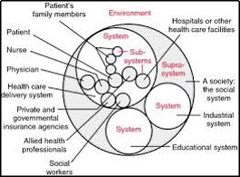
Systems Thinking
A management discipline that concerns an understanding of a system by examining the linkages and interactions between the components that comprise the entirety of that defined system
Notes:
LEAP Session 5 Achieving Results
A system is an organized collection of parts that are highly integrated to accomplish an overall goal. As an example, our organization is made up of many smaller systems to include administrative and management functions, groups and individuals. If one part of the system is changed, the nature of the overall system is often changed.
A high functioning system continually exchanges feedback among its various parts to ensure that they remain closely aligned and focused on achieving the goal of the system. If any part of the system seems weakened or misaligned, the system makes necessary adjustments to more effectively achieve its goals.

Slide 160
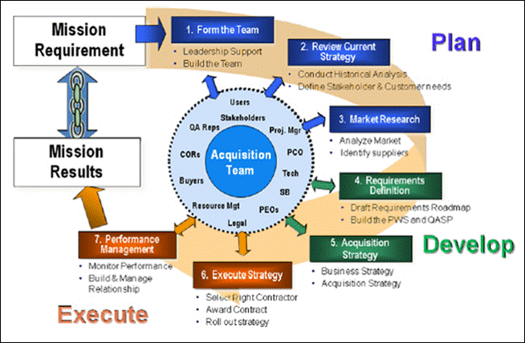
Acquisition Systems
Notes:
LEAP Session 5 Achieving Results
Let’s take a look at our Acquisition Systems…

Slide 161
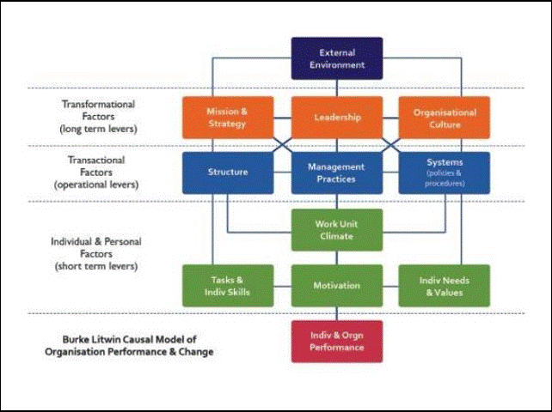
Burke-Litwin Model of Organizational Change and Performance
Notes:
LEAP Session 5 Achieving Results
The Burke Litwin model of organizational change and performance, shows the various drivers of change and ranks them in terms of importance. This model is expressed diagrammatically, with the most important factors featuring at the top. The lower layers becomes gradually less important. The model argues that all of the factors are intergated (to greater or lesser degrees); therefore, a change in one will eventually affect all other factors.
Burke-Litwin believe environmental factors to be the most important driver for change. Important elements of organizational success, such as mission and strategy, leadership and organizational culture, are often impacted by changes that originate outside the organization.

Slide 162
Identifying and Dealing with Drivers for Change
Driver for Change | Examples…
External Environment | Trends, legislation, competition and the economy
Mission and Strategy | Foundation of all activity
Leadership | Attitudes and behaviors of senior colleagues
Organization Culture | Way things are done “here”
Structure | Organizational chart, reporting relationships
Work Unit Climate | Location change, working hour change, change in personnel
Task Requirements and Individual Skills / Abilities | Right skills available or need to be sought outside of the organization
Individual Needs and Values | Team dynamics
Employee Motivation | Key to effective change
Notes:
LEAP Session 5 Achieving Results

Slide 163

How to Lead in Constant Change
https://www.ted.com/talks/jim_hemerling_5_ways_to_lead_in_an_era_of_constant_change
Notes:
LEAP Session 5 Achieving Results
Putting people first…
Inspire thru purpose / align to mission
Go All In…
Enable people who have capabilities
Culture of continuous learning
Directive but inclusive vision

Slide 164
Change Management
Assess, plan and prepare the organization – leverage knowledge across disciplines
Shape expectations and communicate the change – ensure stakeholders are informed, involved and prepared
Facilitate a smooth, efficient and effective implementation to maintain productivity and minimize risk and confusion
Measure successful adoption of change and create a feedback loop to make adjustments
Notes:
LEAP Session 5 Achieving Results

Slide 165
Goals of Change Management
Hard Side > Management | Soft Side > Leadership
Processes | Attitude
Procedures | Buy-In
Policies | Commitment
Structures | Communication
Systems | Overcome Resistance
Tools | Shape Expectations

Slide 166
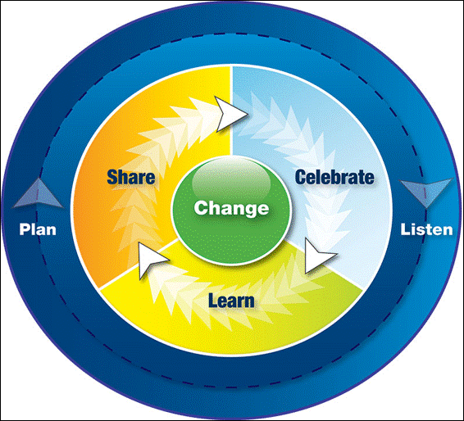
Change Communication Plan
Notes:
LEAP Session 5 Achieving Results
Change communication should consider: audience, content, timing/frequency, delivery method, who develops and delivers the message
Six Phase Approach to Change Communication
Identify Stakeholders
Evaluate communication channels
Identify communication risks
Develop a timeline and engagement strategy
Communicate – multiple ways
Evaluate feedback and adjust
Lead further discussion with the group emphasizing how collaboration can lead to effective change management.

Slide 167
Questions?

